Slide 1


Number Guessing Game
Atharva Patil-1262250887
Vinit Patil-1262252115
Aditya Gawade-1262252783
Harshit Makhwana-1262253231
Parth Gore-1262252845

Slide 2
Introduction
•​Overview: A fun and engaging interactive console application designed to predict a randomly selected number.
•​Educational Goal: Aims to deepen the grasp of C programming fundamentals and logical reasoning.
•​Dynamic Experience: Uses random number generation and conditional loops to create a unique challenge for every session.
•​Real-time Interaction: Offers an immersive journey by demonstrating real-time algorithmic responses to player input.

Slide 3
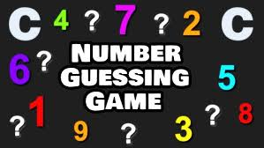
Game Rules
•​The Secret Number: The computer randomly selects a number within a defined range (1 to 100).
•​Player Input: Players enter their guesses to identify the chosen number, promoting critical thinking.
•​Immediate Feedback: The program indicates whether the guess is "Too High", "Too Low", or "Correct".
•​Winning Condition: The game continues until the player finds the concealed number, after which total attempts are displayed

Slide 4

Objectives
•​To develop a functional Number Guessing Game using the C language.
•​To practice and implement fundamental concepts like random number generation and user input management
•​To master control structures, specifically how loops and conditionals interact to create game logic.
•​To enhance problem-solving and analytical skills through the creation of a real-time feedback system.

Slide 5

Algorithm
1. Start
2. Generate random number
3. Accept user guess
4. Compare with actual number
5. Display result
6. Repeat until correct
7. Stop

Slide 6
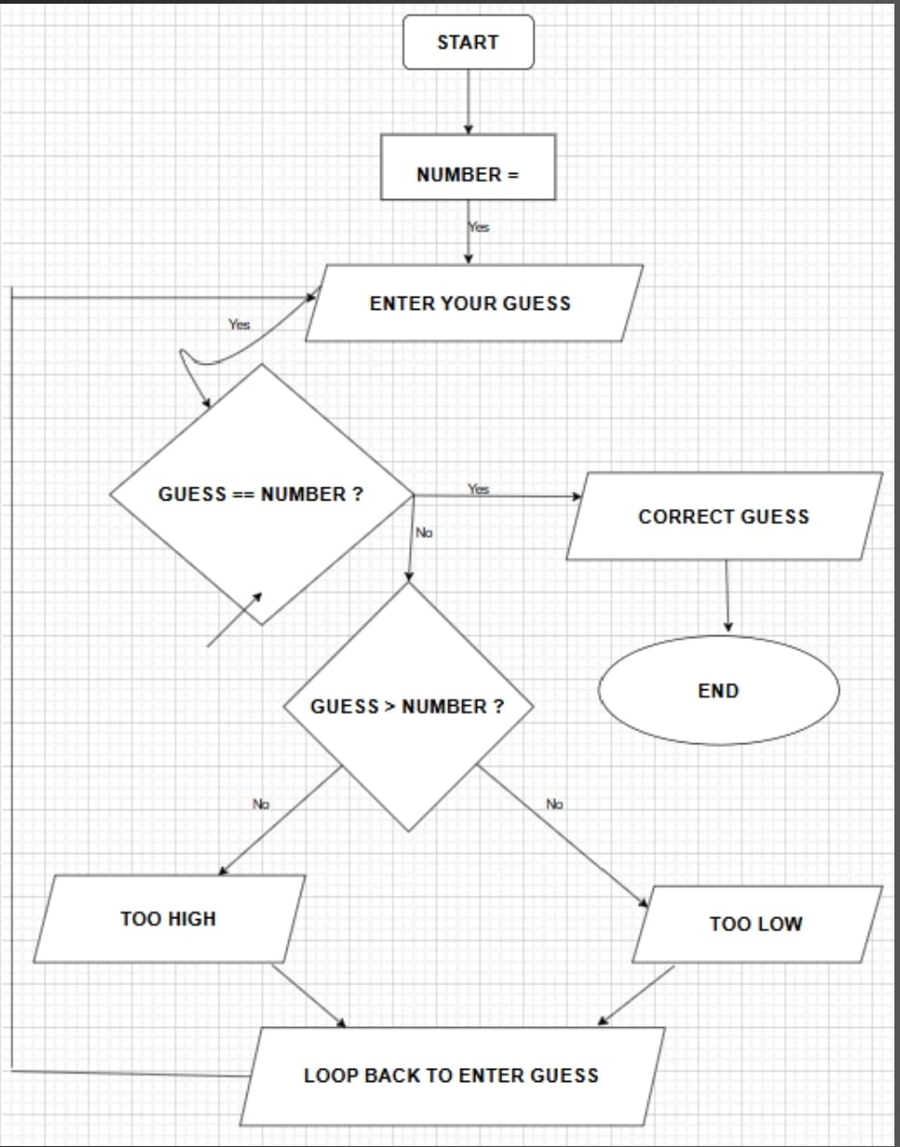
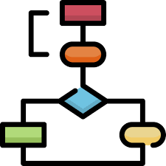
Flow chart

Slide 7
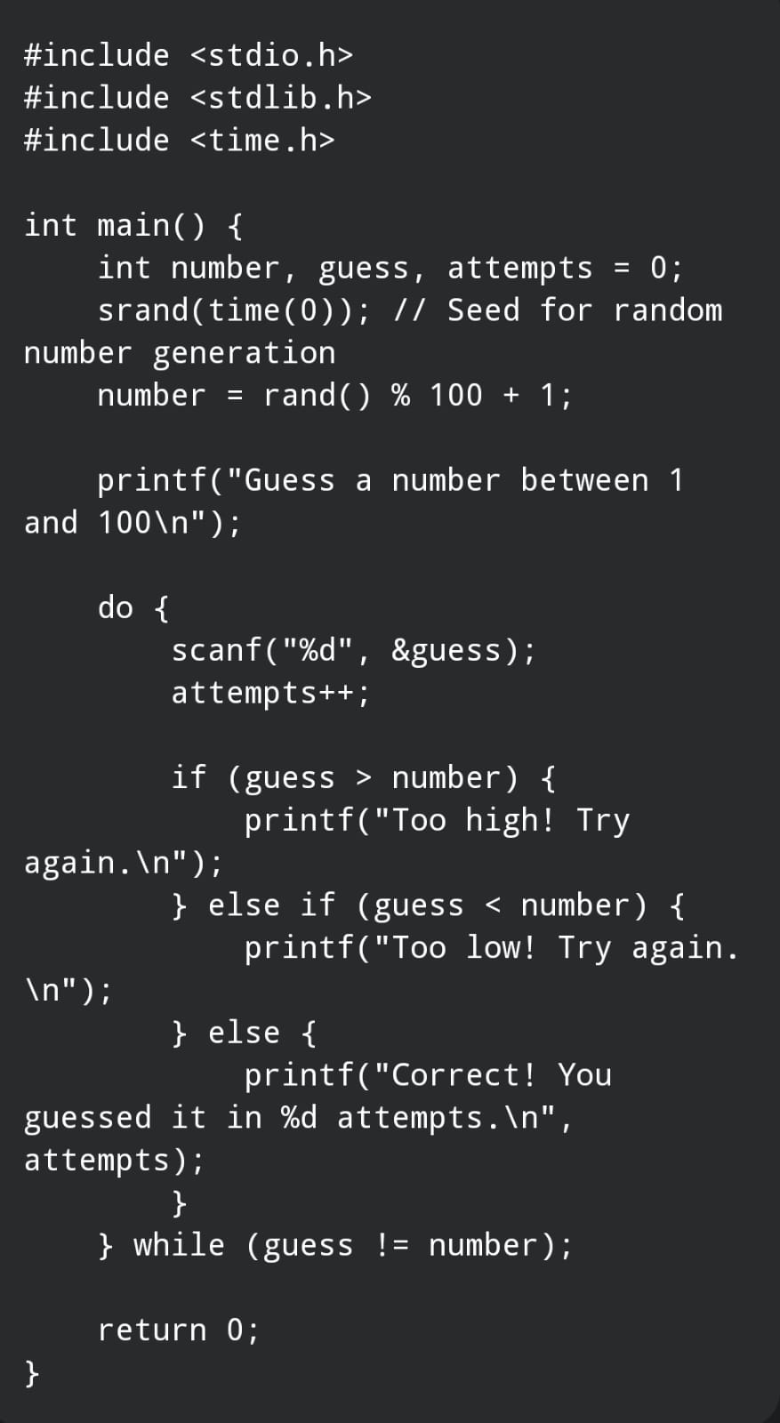

Program

Slide 8
Sample Output
•​Header: Welcome to the Number Guessing Game!
•​Input: 50
•​Output: Too low! Try again.
•​Input: 75
•​Output: Too high! Try again.
•​Input: 63
•​Output: Correct! You guessed it in 3 attempts.

Slide 9

Summary
•​Game Concept: Enhances problem-solving and analytical skills through interactive play.
•​Language Mastery: Reinforces core C skills like variables, control structures, and functions.
•​Visual Clarity: Utilizing flowcharts helps in visualizing program structure and decision-making.
• This project is best to learn C programming concepts

Slide 10
THANK YOU

